Slide 1


Software Design Method
Health Care Information System
Group:
Juanyta Powell
Junhao Zhang
Qingyu Fan
Gireesh Rajulapudi

Slide 2
Contents:
Motivation
Related Work
Describe two Use Case with
o Use fully dressed template
o Develop the Domain Model
o Develop the sequence diagram
o Develop the Design Class Diagram
o Map it to Code

Slide 3

Motivation
Health Care Information Systems can improve hospital's cost control, increase the timeliness and accuracy of patient care and administration information, increase service capacity, reduce personnel costs and improve the quality of patient care. However, experience shows that most of these benefits will not occur automatically following system implementation. Operational problems may exist that diminish information timeliness, accessibility, and accuracy.
So we use what we learn in the Software Design Method class to build a more user friendly and more efficient Health Care Information System.

Slide 4
Related work
Three major parts help us through the project:
Paper <Best Practices in the Design and Development of Health Care Information System>
Website & software: “http://www.open-emr.org”
The textbook(Applying UML and Patterns: An Introduction to Object-Oriented Analysis and Design and Iterative Development)

Slide 5
Use Cases of the Projcet
1. Appointment System - Schedule /view / update /cancel appointment
2. Patient registration / create patient
3. Medical records - Review / update patient medical records
4. Treatments - Schedule /view / update /cancel treatment / lab
5. Prescribe medication
6. Reorder medication (patient refills / reorders medication)
7. Process medical payment

Slide 6
What we choose?
1. Appointment System - Schedule /view / update /cancel appointment
2. Patient registration / create patient
3. Medical records - Review / update patient medical records
4. Treatments - Schedule /view / update /cancel treatment / lab
5. Prescribe medication
6. Reorder medication (patient refills / reorders medication)
7. Process medical payment

Slide 7
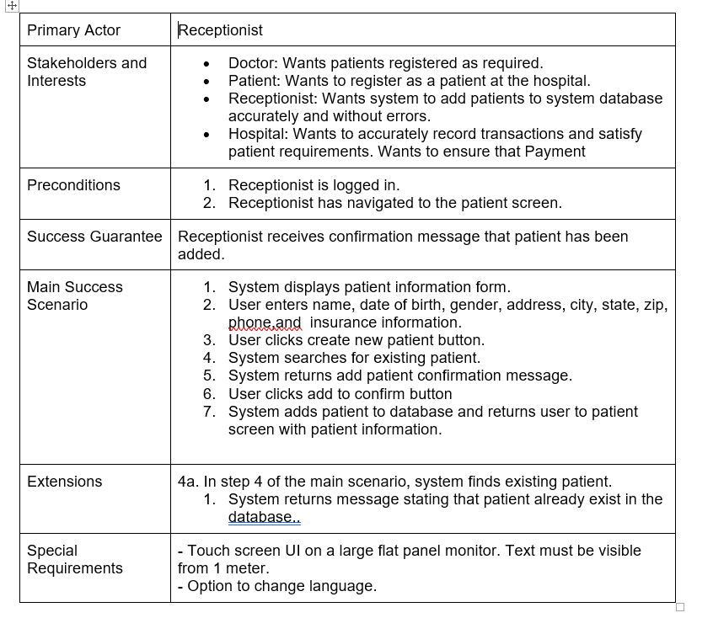
Register patient use case

Slide 8
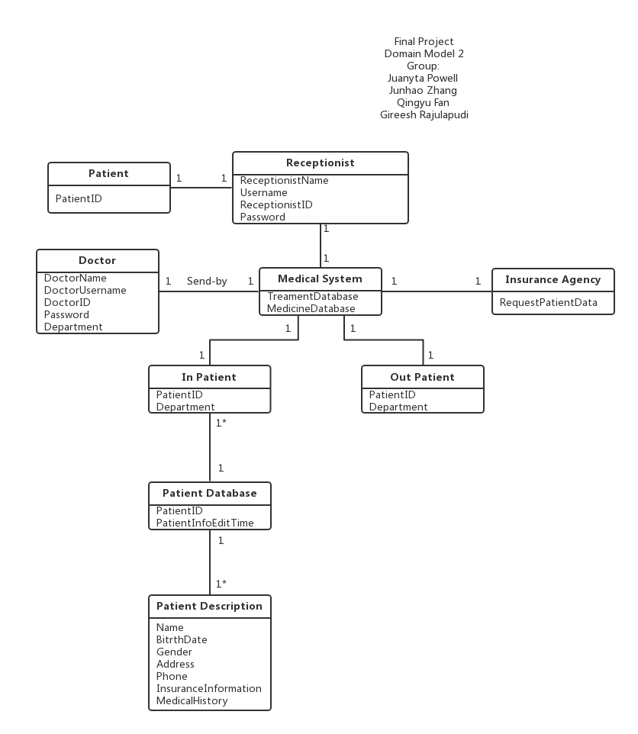
Register patient domain model

Slide 9
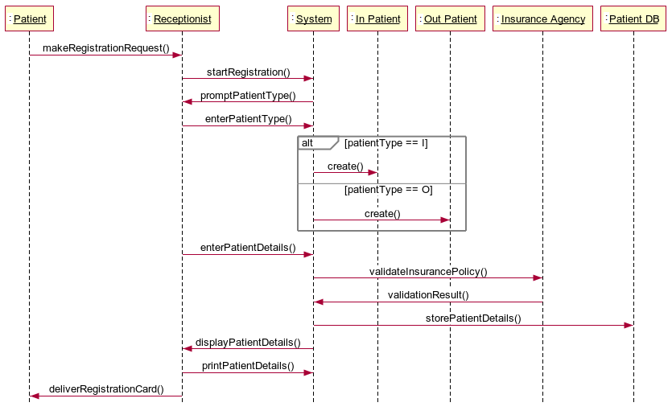
Register patient sequence diagram

Slide 10
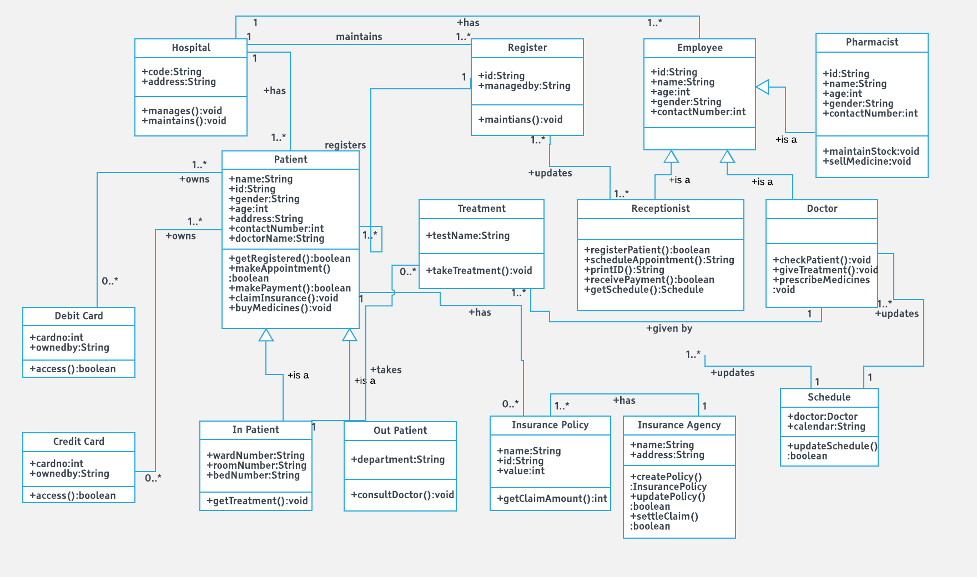
Register patient design class diagram

Slide 11
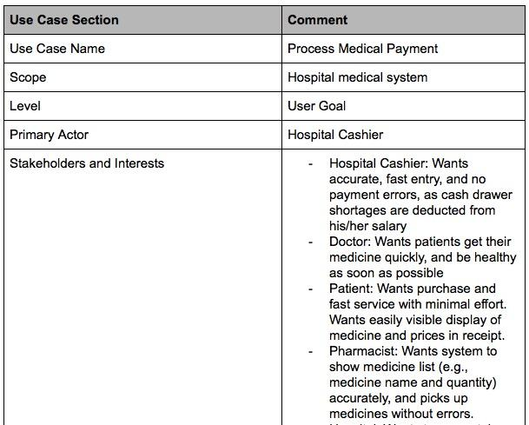
The second Use Case

Slide 12
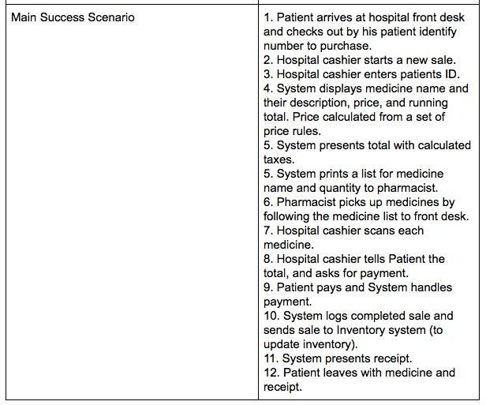
The second Use Case

Slide 13
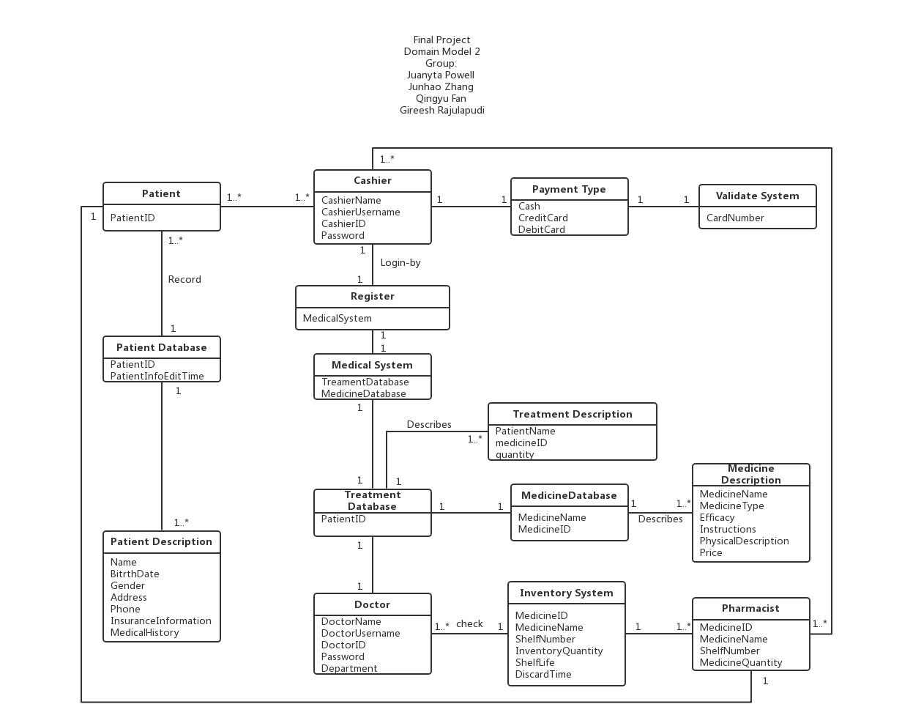
The second Domain Model

Slide 14
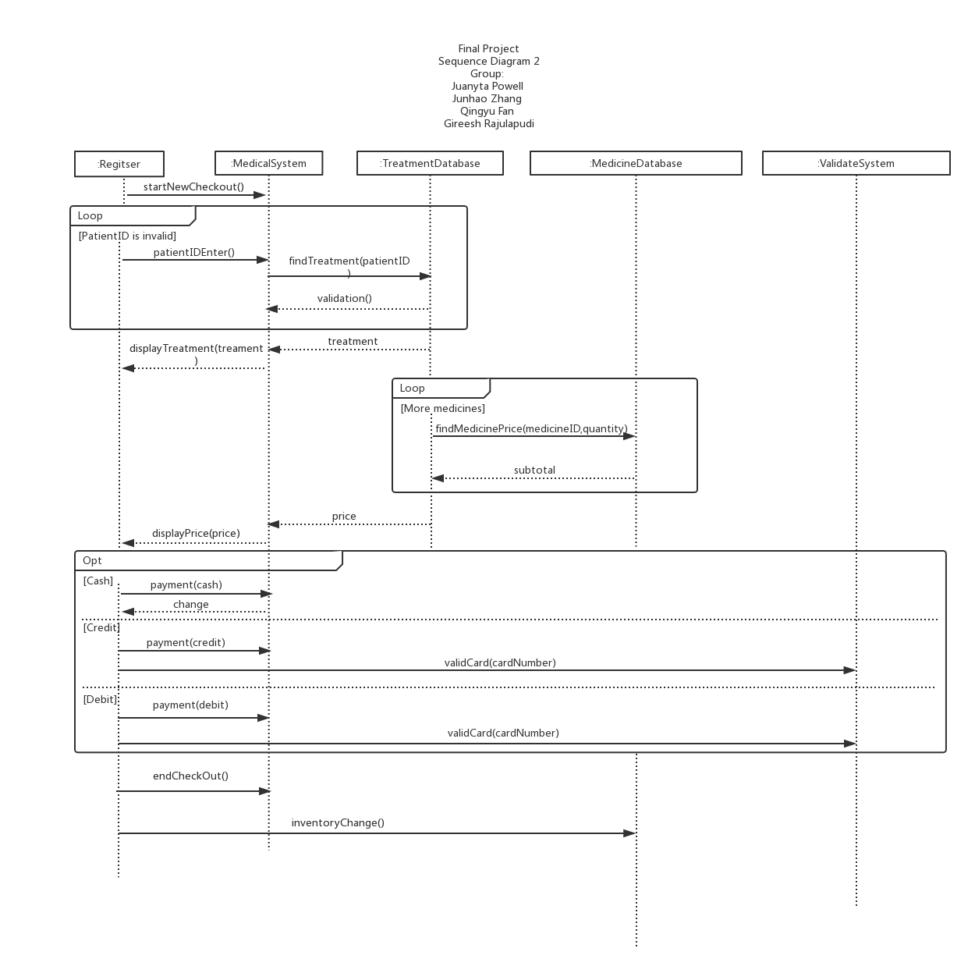
The second Sequence Diagram

Slide 15
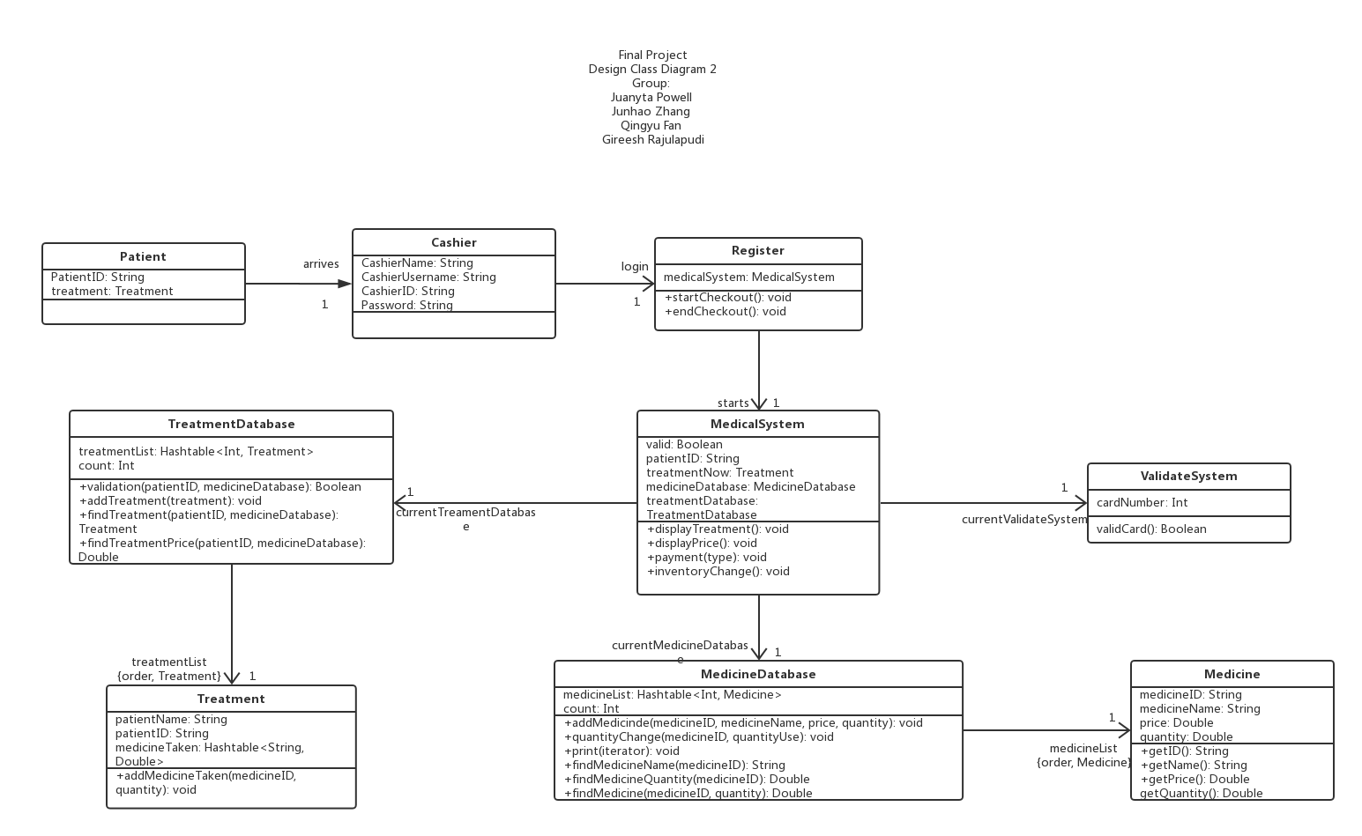
The second Design Class Diagram

Slide 16
Code

